Slide 1







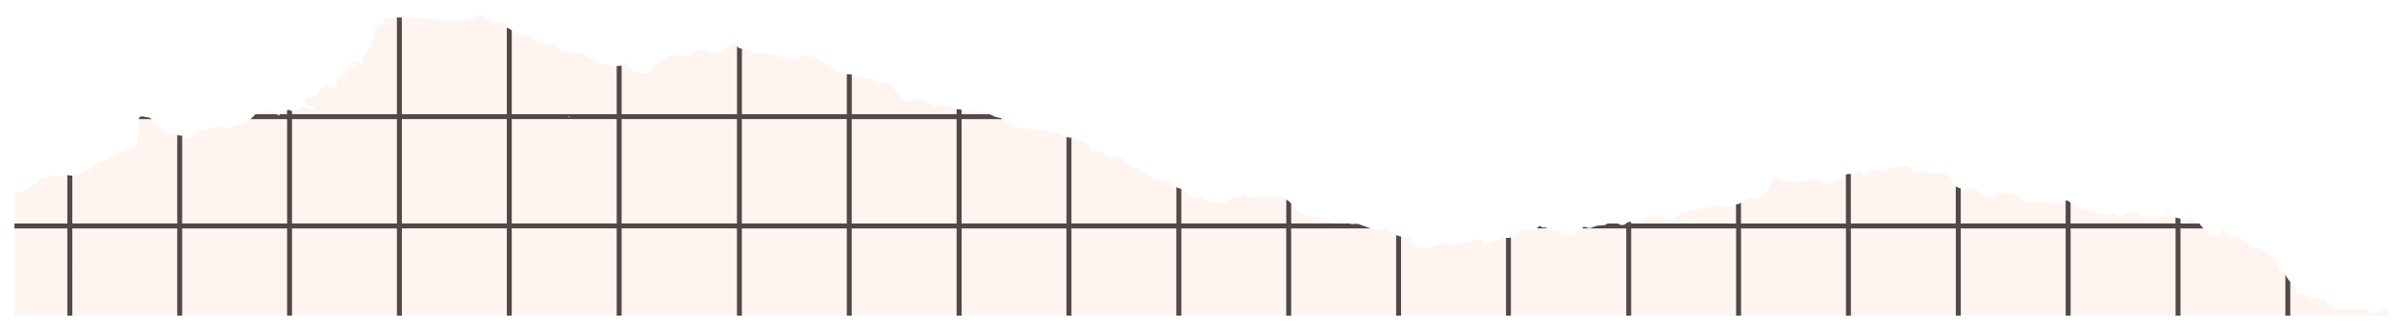
WASLA PLATFORM PRESENTATION
“Connecting Fresh Graduates With Startups”

Slide 2


INTRODUCTION
- Fresh graduates often face challenges in finding jobs.
- Startups struggle to reach qualified candidates.
- Lack of a structured platform connecting both parties.
Our Goal:
- Wasla is a two-sided platform for startups and fresh graduates.
- It connects startups with fresh graduates.
- Uses a virtual coin system to manage job postings.
- Offers feedback and profile building features.

Slide 3


TEAM
Ahmed Mahmoud
Mariam Ibrahim
Rahma Sabry
Hoor Ashraf
Eman Elsayed

Slide 4


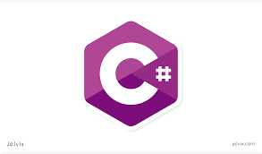

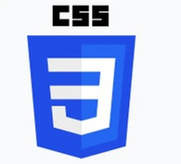

Technology Used
HTML
Used to Structure the website.
C#
Used To Structure The Back-end
CSS
SQL
Used to Style The Website.
Database management and quering with entity.

Slide 5
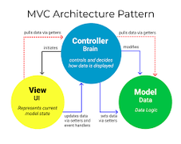



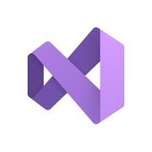
Technology Used
MVC
GitHub
separate concerns organize our ASP.NET Core project more effectively.
manage our ASP.NET Core MVC project efficiently.
.NET
VS COMMUINTY
Back-End Framework.
Used for Developing the website.

Slide 6

OBJECTIVES
- Connect job seekers with startup Recruiters.
- Create a fair and traceable recruitment process.
- Build a trusted community using feedback and ratings.
- Manage transactions through a coin-based system.

Slide 7


Target Audience
Fresh graduates seeking entry-level jobs.
Startups looking to hire motivated junior employees.
Platform Roles Content
EMPLOYEE: BUILDS A PROFILE AND APPLIES FOR JOBS.
Recruiter: POSTS JOB OFFERS AND REVIEWS APPLICANTS.
ADMIN: MONITORS AND MANAGES PLATFORM DATA.

Slide 8

PLATFORM FEATURES
Login/Registration with role selection Dynamic.
dashboards for employees/recruiters Job.
posting and job search .
Resume uploads and profile builder Coin-based. job posting system.
Application tracking and feedback.

Slide 9

DATABASE DESIGN
Database Desin Using The Entity Framework:
ORM (object-Relational Mapping): The Entity Framework Was used to connect the code to the database, often without need to manually write SQL queries. Models: Object models (entities) were created to represent tables in the database, such as Users, Employees, Recruiters, Jobs, Skills, Education, Experience, CoinHistory, Application, ApplicationHistory and Feedback.
Table Relationships: Relationships between tables were difined, such as the relationship between Users & Recruiters (1:1) or Employees & Experience (N:1) or Employees & Jobs (N:M).
Sql Server as a Database:
Flexibility and Performance: SQL Server was chosen because it offers high data performance, along with features Such as Skills and Apply.
Complex Queries: SQL Server allows as to write complex queries to improve Performance Such as ApplicationHistory and Apply.

Slide 10


DATABASE INTEGRATION
We used EF Core to connect our models with the database Operations: Create, Read, Update, Delete (CRUD) Auto-generates tables and migrations from models .
Simplifies data access and manipulation

Slide 11

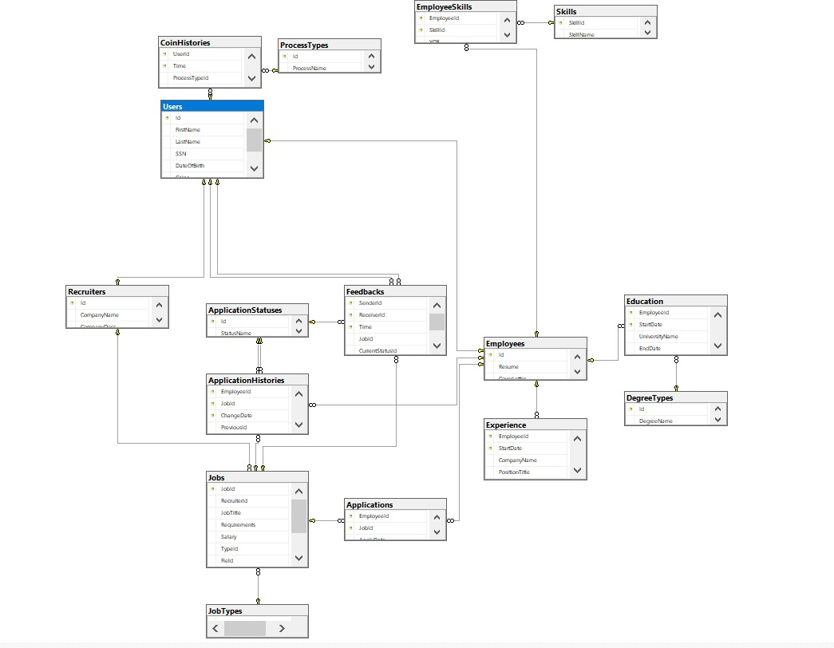
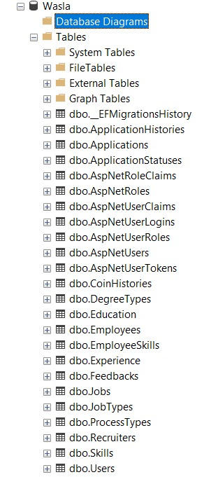
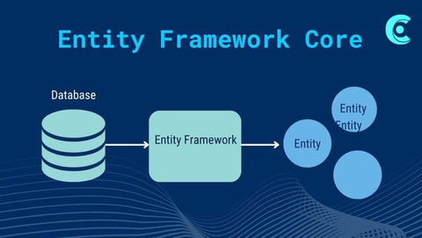
ERD Overview

Slide 12

SYSTEM ARCHITECTURE
Front-end: HTML5,CSS (Bootstrap-based custom styles) .
Back-end: ASP.NET Core MVC.
Database: SQL Server + EF core.

Slide 13

PLATFORM WORKFLOW
1. User Registration.
2. Job Posting & Publishing.
3. Job Discovery & Applications.
4. Application Review & Hiring.
5. Feedback & Reputation System.

Slide 14
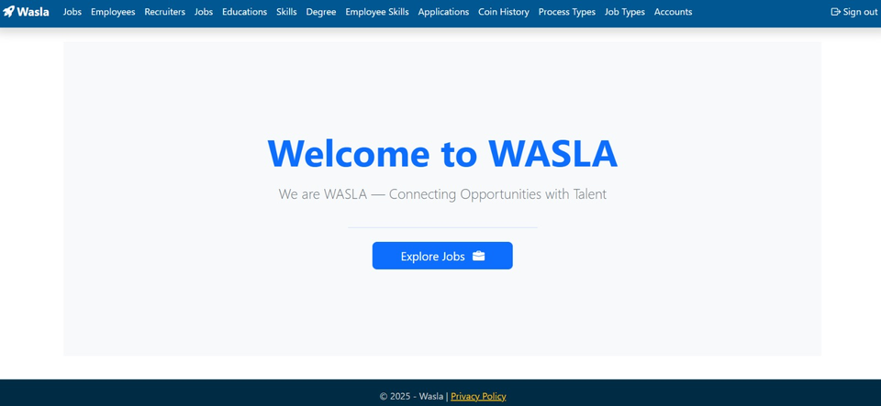
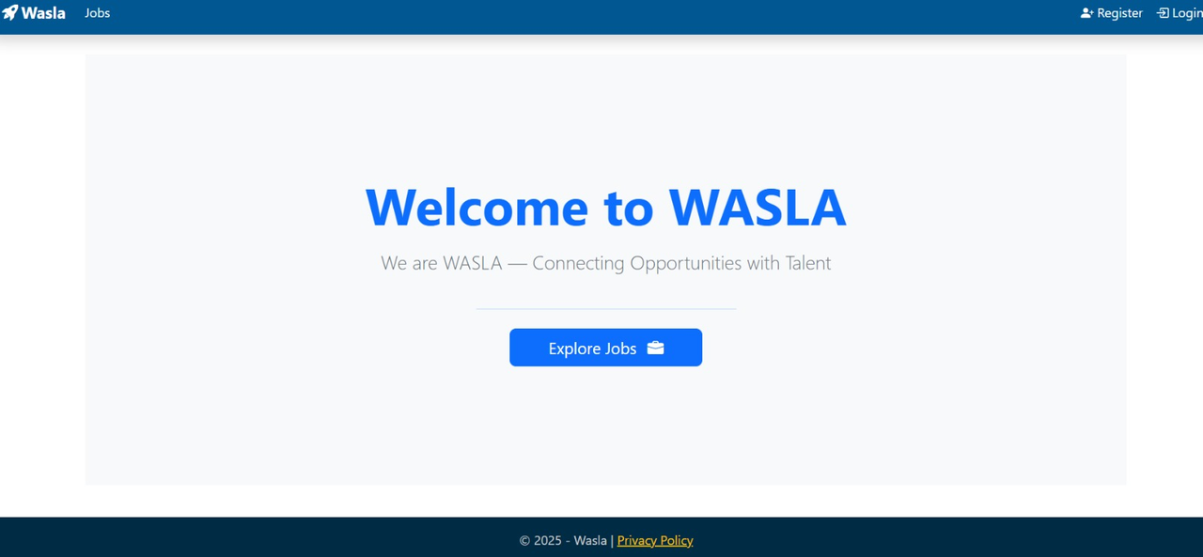

Home Page

Slide 15

LOGIN & REGISTRATION PAGE
Role-based form (Recruiter/Employee).
Fields: name, email, password, resume, company details.
Dynamic layout using Bootstrap tabs.

Slide 16
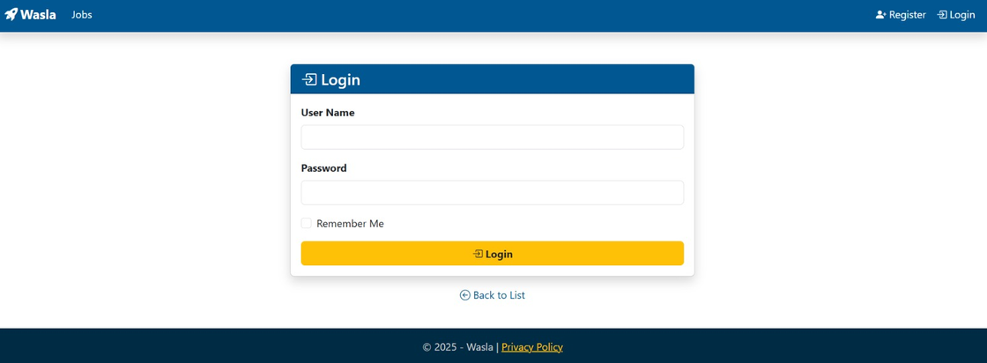
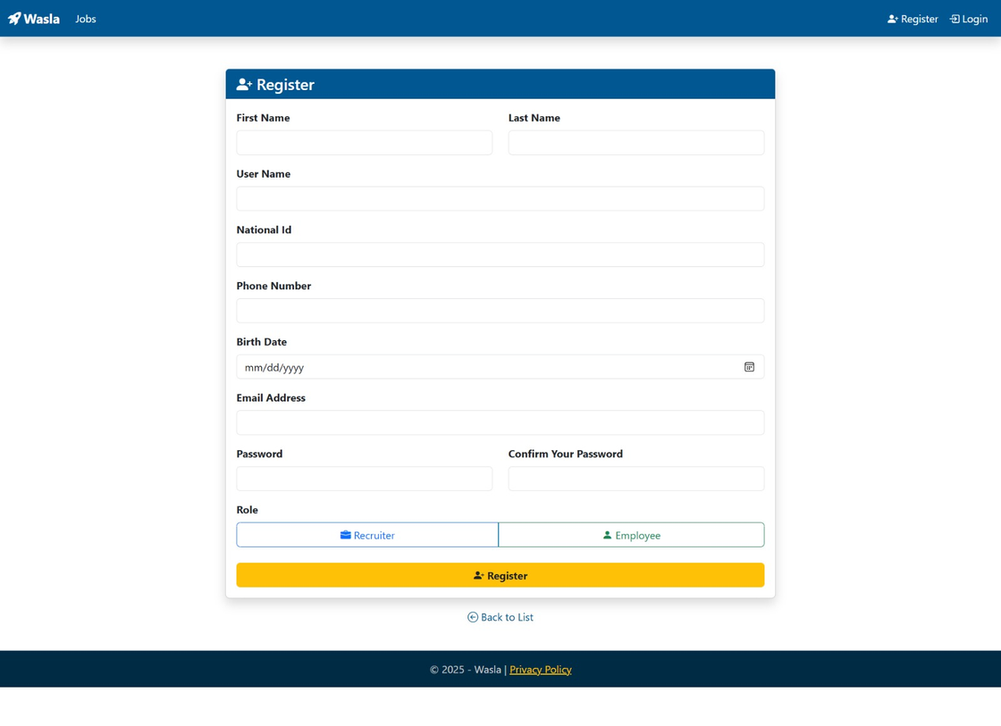
LOGIN & REGISTRATION PAGE

Slide 17

Recruiter REGISTRATION
EMPLOYEE REGISTRATION
- Fill company details (name, industry, contacts).
- Account is created and linked to Recruiter profile.
- Initial coin balance is granted upon signup.
- Fill personal details and upload resume.
- Account linked to employee profile.
- Can start job searching and applying instantly.

Slide 18
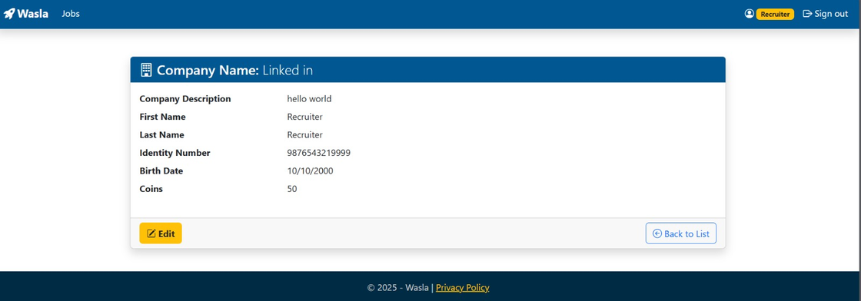
Recruiter DASHBOARD
Company profile & contact info.
Applicant list per job.
Post job with required fields.
Application status timeline.
View, update, or close jobs.
Application status timeline.
Coin balance and history.

Slide 19


POST JOB PAGE
Recruiters Create Job Posts With:
Fields: title, requirements, salary, type, expiry date and Category.
“Cost: 10 coins” per job (Coin Cost is calculated for Publishing).
Saved in System As Draft.
Submit & confirmation alert.

Slide 20
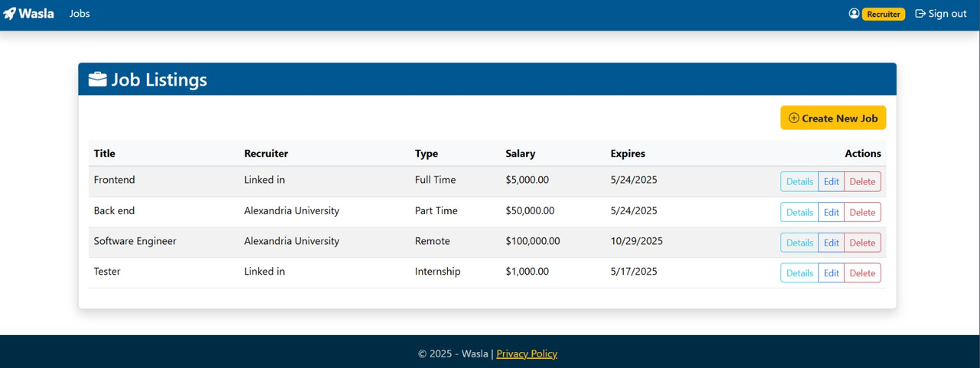
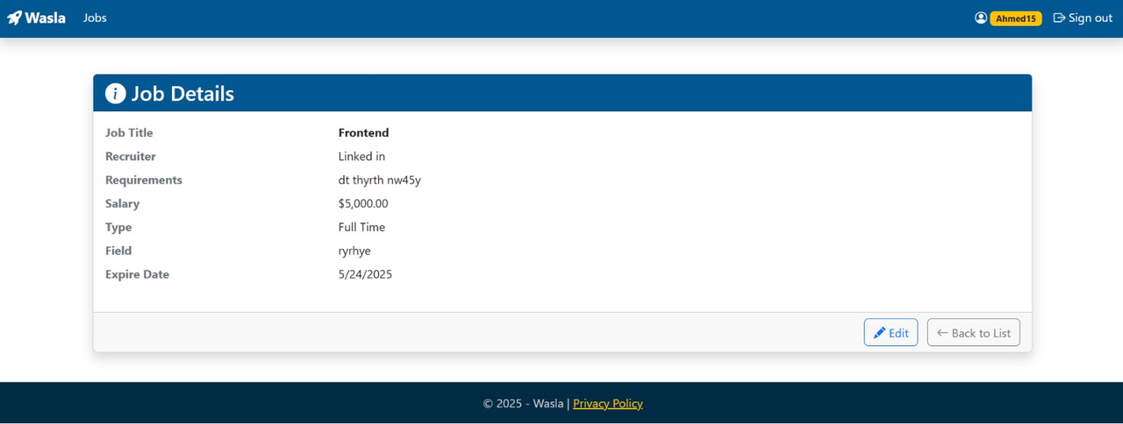
JOB PAGE

Slide 21

JOB PUBLISHING
- If coin balance is sufficient → Deduct and publish.
- If not → Redirect to coin purchase flow - Transactions are logged.

Slide 22


Coin System Overview
- Recruiters use coins to publish jobs.
- Coins can be purchased in packages.
- All transactions are tracked and secure.

Slide 23
Coin Purchase Flow
1. Low balance detected.
2. Redirected to Buy Coins page.
3. Choose a coin package.
4. Payment processed (manual or via gateway).
5. Coin balance updated immediately.

Slide 24
Coin Transaction Logs
-CoinPurchaseRequests: requests tracks purchase.
- CoinTransactions: Logs each coin activity.
- RecruiterWallet / CoinBalance: Current coin status.

Slide 25
Purchase Example
- Recruiter Paid 10 coins.
- Pays via PayPal (or manual mode). - Coins added to wallet.
- Job publishing continues instantly.

Slide 26
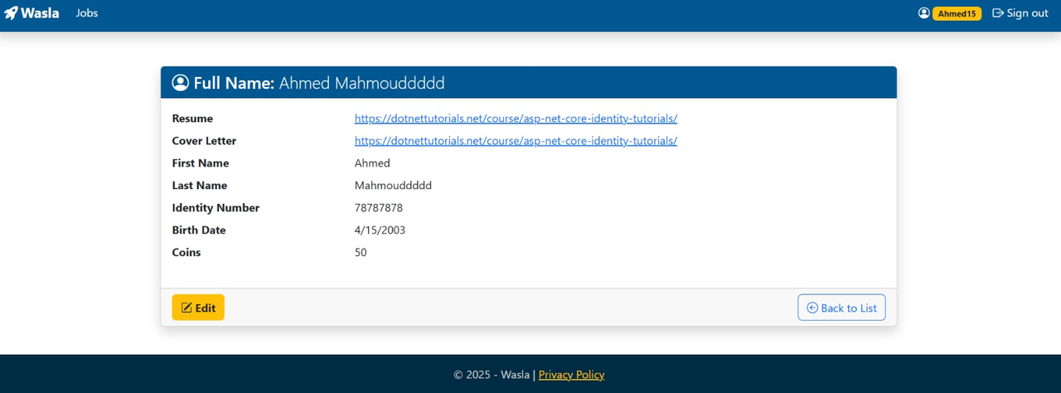
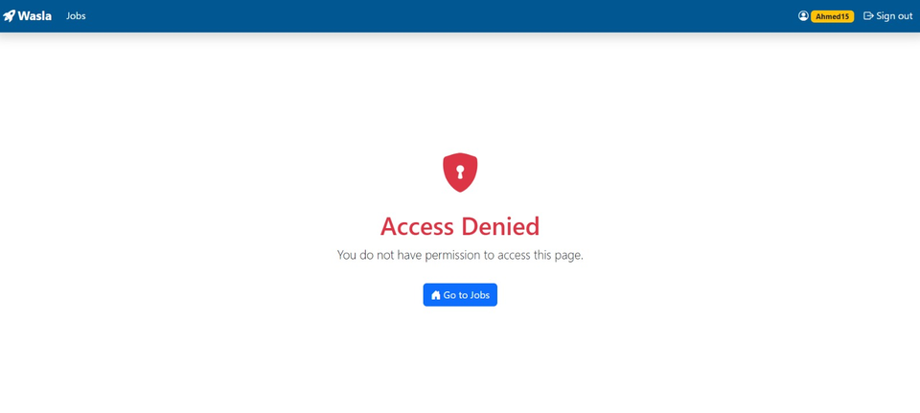
EMPLOYEE DASHBOARD
Search Jobs Using Filters:
(Location, Category, Salary).
Resume and cover letter.
upload Profile builder: education, experience, skills.
View job Details Apply button per job card.

Slide 27
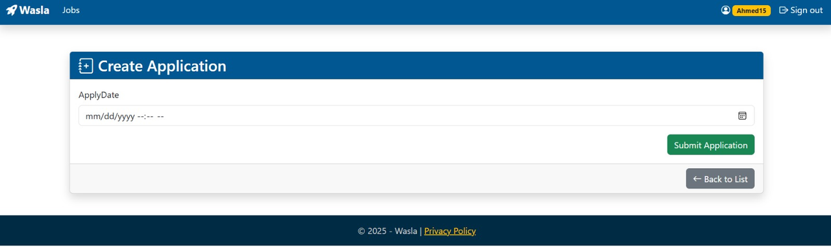
APPLICATION HISTORY
Table of applied jobs
- Applications: Each job application.
- ApplicationHistory: All status changes.
- Users: Linked to applicants.
Status updates using ApplicationHistory
Status Flow:
1. Pending.
2. Interviewing.
3. Accepted or Rejected.
- Users receive real-time notifications.

Slide 28


HIRING
Reviewing Applicants
- Recruiters view applicants per job .
- For each applicant: Schedule Interview, Reject, or Accept.
Final Hiring Action
If accepted:
- Status marked as "Accepted".
- Job marked as "Filled".
- Coins may be deducted.
- Feedback enabled for both parties.

Slide 29

FEEDBACK FORM
Comment + star rating
- After hiring, both users give feedback: Ratings + Comments .
- Stored in UserFeedback table .
- Builds trust and reputation.
Moderation & Flags
- Inappropriate feedback can be flagged. - Admins review and moderate content.
- System ensures respectful interaction

Slide 30

Back-end Technology
We used ASP.NET Core MVC to build the backend.
MVC = Model - View - Controller pattern.
Data is processed on the server side and rendered into views.
Backend handles form submissions, routing, and logic.

Slide 31
Why ASP.NET CORE MVC?
Built-in support for models, views, and controllers.
Strong performance and security.
Easy to connect with Entity Framework and SQL Server.
Scalable structure for future expansion.

Slide 32
Back-end Responsibilities
User registration and login (based on roles).
Storing and retrieving jobs, applications, and profiles.
Processing job posting forms.
Simulating coin-based actions (not real payments).
Feedback submission logic.

Slide 33

Controllers in OUR Project
HomeController: Manages the landing pages and general navigation.
UsersController: Manage user specific data like Firsrt name,SSN,Date of birth,..etc.
AccountsController: Handling security layer for authentication, login and regiser pages.
ProfilesController: Handling role of user to redirect it to suitable pages for his role.
RecruitersController: Manages recruiter-specific data like company info and job posting access.
JobsController: Handles job creation, editing, listing, and job details view.
EmployeesController: Manages employee profiles including resume, education, and experience.
ApplicationsController: Handling Appling process by employee to a specific job.
JobTypesController: Manages job category types (e.g., Full-time, Part-time, Remote).
SkillsController: Handles the available skills for employees to select and link to their profiles.
EmployeeSkillsController: Manages the connection between employees and their selected skills.

Slide 34
Controllers in OUR Project
EducationsController: Allows employees to add, edit, and view their education history.
DegreeController: Manages degree types (e.g., Bachelor's, Master's) used in education records.
CoinHistoryController: Tracks recruiter coin purchases and usage when posting jobs.
ProcessTypeController: Defines the types of coin usage operations (e.g., job post, coin purchase).

Slide 35
Views & Razor Views
Views in ASP.NET Core MVC
Razor
pages
used
to
generate
HTML
dynamically.
Each View is linked to a Controller action.
Data passed via ViewModel or ViewBag.
Examples:
JobList.cshtml,
Register.cshtml,
Dashboard.cshtml

Slide 36


CONCLUSION
- Complete hiring flow implemented.
- Secure and scalable system.
- Real-time tracking and feedback.
- Supports startup and graduate needs.

Slide 37


Future Plans
What is next?
Mobile app Version Real Payment system For Coins
Admin analytics dasboard
AI-baseed job recommendations

Slide 38



THANK YOU
Do you have any Questions?
Project Repo link: https://github.com/Rahma-Sabry/WASLA-Platform.git

